Slide 1
CAPSTONE PROJECT
PROJECT TITLE
Presented By:
Student Name : Dhanushkumar M
College Name & Department : KSR Institute For Engineering And
Technology & B Tech IT

Slide 2
OUTLINE
Problem Statement
Technology used
Wow factor
End users
Result
Conclusion
Git-hub Link
Future scope

Slide 3
PROBLEM STATEMENT
Securing digital images from unauthorized access is a major cybersecurity challenge.
Traditional encryption methods make images unreadable, raising suspicion.
This project hides secret messages inside images by modifying pixel values while keeping them visually intact.

Slide 4
TECHNOLOGY USED
Programming Language: Python 3.11.9
Libraries Used:
OpenCV – Image processing
OS – File handling

Slide 5
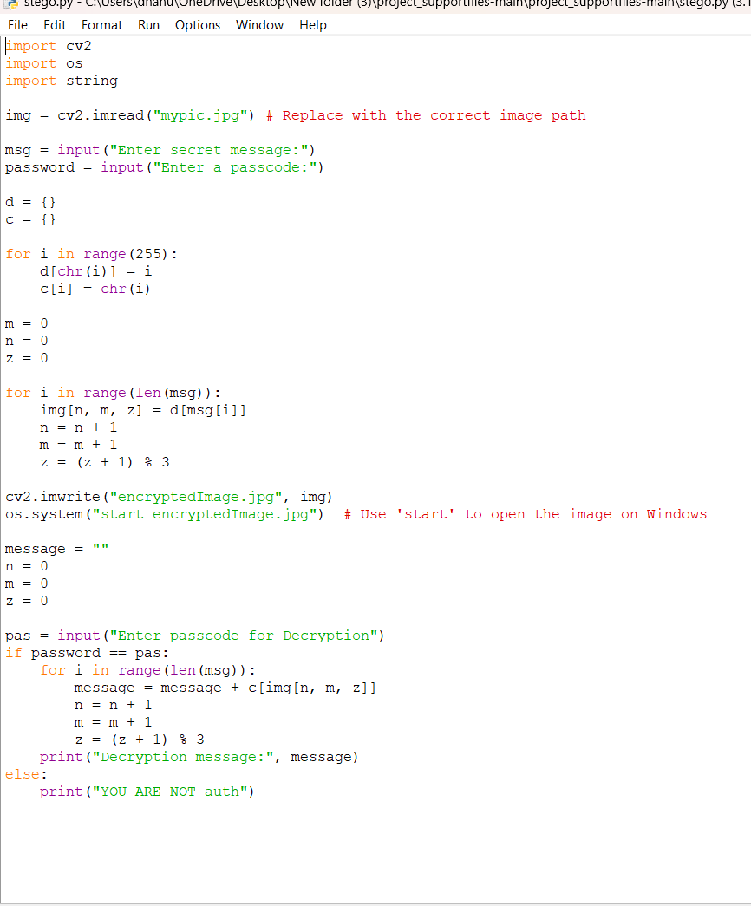
WOW FACTORS
Steganography-Based Encryption: Conceals messages insideimages.
Simple & Efficient: No complex cryptographic keys required.
Lossless Decryption: Image quality remains intact.
Fast Processing: Lightweight and efficient.

Slide 6
END USERS
Cybersecurity Professionals – Exploring steganographic encryption.
Photographers & Digital Artists – Protecting copyrighted images.
Students & Researchers – Learning about encryption & data hiding.

Slide 7
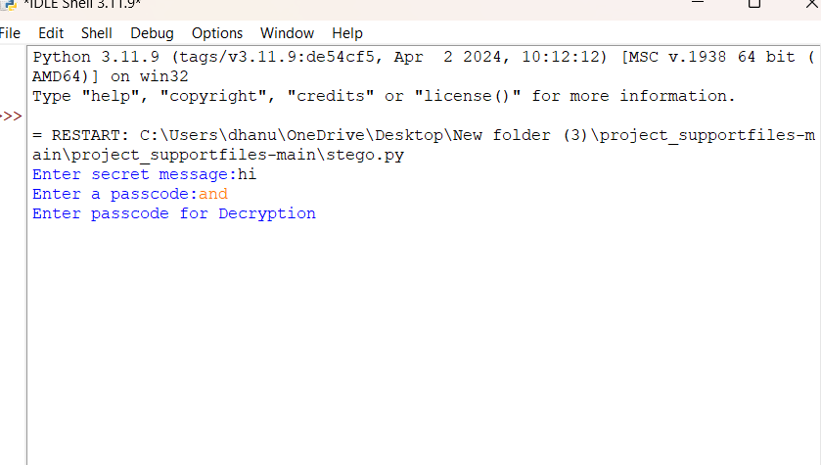


RESULTS
Encrypted Image
Normal image

Slide 8
CONCLUSION
This project demonstrates a simple encryption approach using color manipulation.
Ensures image security while maintaining visual integrity.
Can be expanded with stronger cryptographic algorithms in future versions.

Slide 9
GITHUB LINK
dhanushkumar006/steno

Slide 10
FUTURE SCOPE
Integrating Stronger Encryption Techniques: Using AES for advanced security.
AI-Based Steganalysis: Detecting hidden data in encrypted images.
Expanding File Format Support: PNG, BMP, and other formats.

Slide 11
THANK YOU

